Slide 1


Maha khilfeh
Ramah hawash
Dr.suhad daraghmeh

Slide 2
Fitness&fun
1
2
3
4

Slide 3

Fitness&fun
1
2
Outline
3
4
Click here

Slide 4

Fitness&fun
1
2
introduction
3
Click here
4

Slide 5

Fitness&fun
1
2
Project analysis
3
Click here
4

Slide 6

Fitness&fun
1
2
Er Diagram
3
Click here
4

Slide 7

Fitness&fun
Outline:
Introduction
Project analysis
ER Diagram

Slide 8
Fitness&fun
Introduction :
We chose our project to talk about fitness & fun, which is led by the Bashart team, and they offer as many courses such as boxing, karate and Zumba….. for different people of different ages
The aim of this project is to solve the problem of annuities, so that they are done on tables instead of papers.

Slide 9
Fitness&fun
Project analysis:
At fitness & fun club we have many participants who will be in many courses if they want, which the course can taken by many participant, and train by many trainer And every participant has a ID ,name, birth date ,address , telephone number , every course has an ID ,name. and every trainer has an ID ,name birth date , address ,telephone number.so there will be a lot of different date to every course train by different trainer .

Slide 10
Fitness&fun
And we need a relationship with their guardian and we need relative if something emergency happen has a name, ID, relationship with participant, and every participants' guardian has information like name, ID, telephone number, email.
And we need to know a lot of information about the participant’s health like what illness name to take care of the participant.
And every participant may have a many installment if he participates in different courses and they paid by his guardian.

Slide 11
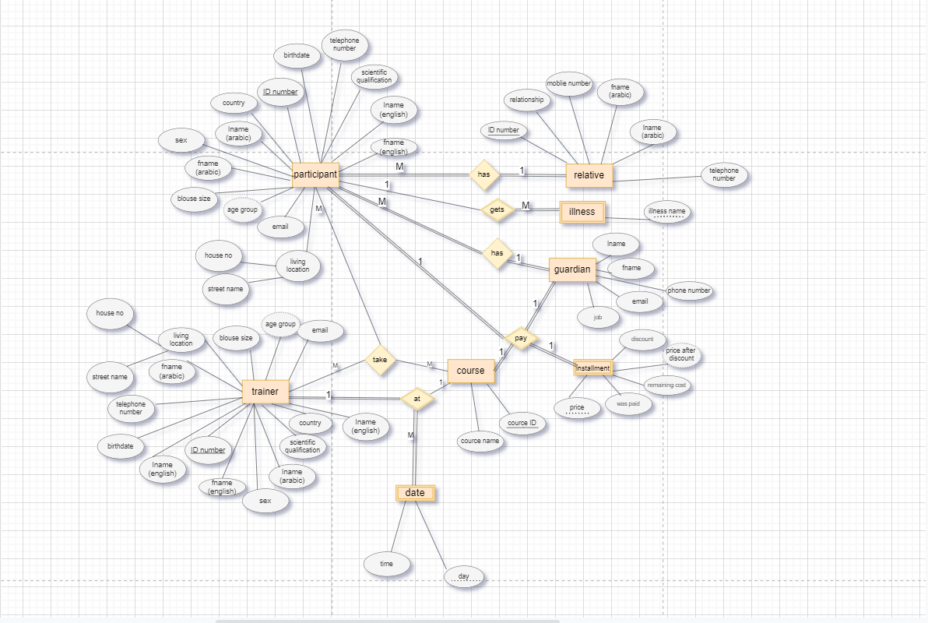
Fitness&fun
ER Diagram:

Slide 12

Fitness&fun

